Slide 1
CSS – Continued..
Instructor: Manu Peethambar
E-mail: cm13055@umbc.edu
Telegram handle: @manupeethambar888
Slides: https://github.com/manupeethambar888/webdev

Slide 2
CSS Rounded Corners
With the CSS border-radius property, you can give any element "rounded corners".
https://www.w3schools.com/css/css3_borders.asp
CSS Border Images
With the CSS border-image property, you can set an image to be used as the border around an element.
https://www.w3schools.com/css/css3_border_images.asp
CSS Multiple Backgrounds
In this chapter you will learn how to add multiple background images to one element.
https://www.w3schools.com/css/css3_backgrounds.asp

Slide 3
CSS Shadow Effects
With CSS you can add shadow to text and to elements.
https://www.w3schools.com/css/css3_shadows.asp
CSS Text Effects
CSS Text Overflow, Word Wrap, and Line Breaking Rules.
https://www.w3schools.com/css/css3_text_effects.asp
CSS Web Fonts
Web fonts allow Web designers to use fonts that are not installed on the user's computer.
https://www.w3schools.com/css/css3_fonts.asp

Slide 4
CSS Multiple Columns
The CSS multi-column layout allows easy definition of multiple columns of text - just like in newspapers.
https://www.w3schools.com/css/css3_multiple_columns.asp
CSS User Interface
CSS resize and outline-offset.
https://www.w3schools.com/css/css3_user_interface.asp
CSS Variables
The var() function can be used to insert the value of a custom property.
https://www.w3schools.com/css/css3_variables.asp

Slide 5
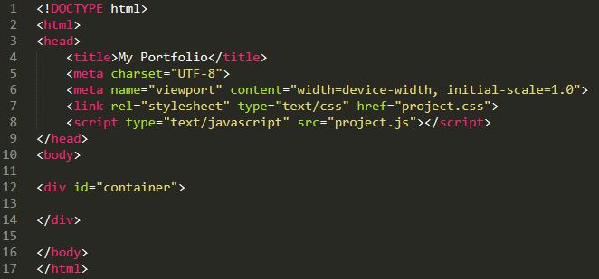
Project – First Layout Setup
Type this is your index.html file:

Slide 6
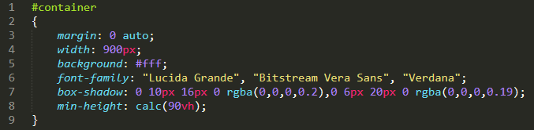
Project – First Layout Setup
Type this is your project.css file:

Slide 7
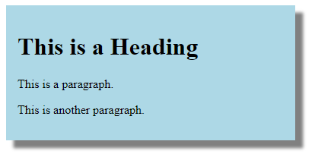
Assignment 11 due – 7/11/2018
Create a sample HTML file to get the output as below:
Save this as “assignment11.html” in Homework folder in your repository “Assignments_yourname”.
Commit and push the changes to the repository.

